Slide 1
Regional Energy trading
Abdullah Alawad

Slide 2
Objective
Study the economic and technical impact of reginal interconnection of power systems with GCC and Egypt
Research questions
What are the operational savings for each country from energy trading or sharing reserves?
What is the implication of regional trade on electricity price in each country?
How do fuel subsidies impact the trades?
How energy exchange can impact generation capacity requirements and ramping requirements in each country?
What is the economic impact of changing the dispatch practice (e.g. day ahead, intra-day and real time)?
Map of GCC and Egypt

Slide 3
power systems operation in the region
Saudi Arabia
ECRA ensures the adequacy, reliability, quality and cost efficiency of the power supply
MOE oversees the electricity industry
The principal buyer (still under SEC) uses PROMOD software to perform the dispatch
The control unit of SEC performs manual real-time dispatch for demand deviations based on Merit Order Tables (MOTs)
Automatic Generation Control (AGC) is used for load following services
Bahrain
Electricity and Water Authority (EWA) acts as the single buyer
Generation comes from several private companies
The EWA also acts as the regulatory authority for the power sector
The Ministry of Electricity and Water is responsible for electricity production and distribution in Bahrain.
Kuwait
Vertically integrated utility owned and operated by the Ministry of Electricity and Water
UAE
Each of the seven emirates is organized differently, with four different service providers
Abu Dhabi Regulation and Supervision Bureau acts as the regulatory authority in Abu Dhabi (unbundled transmission from generation)
Notes:
Saudi Arabia
The Electricity and Co-Generation Regulatory Authority (ECRA) was created with the mission to ensure the adequacy, reliability, quality and cost efficiency of the power supply. Oversight of the electricity industry fell under the Ministry of Energy (MOE).
The Principal buyer (PB) of Saudi Electricity Company (SEC) uses PROMOD software to perform the dispatch for the day ahead and occasionally for intra-day timeframes.
Then, it performs manual real-time dispatch for demand deviations based on Merit Order Tables (MOTs) produced on the previous day.
Automatic Generation Control (AGC) is used for load following services (not all Gas Turbine (GT) units are equipped to provide this service).
Bahrain
Electricity and Water Authority (EWA) acts as the single buyer of power from plants of several private companies.
The EWA also acts as the regulatory authority for the power sector, as there is no independent regulatory agency.
The Ministry of Electricity and Water is responsible for electricity production and distribution in Bahrain.
Kuwait
Kuwait's power sector is dominated by a vertically integrated utility owned and operated by the Ministry of Electricity and Water.
No independent regulator and Kuwait has only recently approved its first independent power producer.
UAE
The UAE's power sector is organized differently in each of the seven emirates, with four different service providers.
The Emirate of Abu Dhabi's power sector is the most advanced one. There is an independent regulatory agency, the Abu Dhabi Regulation and Supervision Bureau, which regulates all companies undertaking activities associated with electricity production, transmission and distribution.
Abu Dhabi is the only emirate to have implemented a privatization program in the electricity sector and to have unbundled transmission from generation.
Oman
The state-owned Oman Electricity Transmission Company is responsible for the transmission network,
The state-owned Oman Power and Water Procurement Company acts as the single buyer, purchasing all electricity from generators and selling it on to the distribution companies and large consumers.
There are three state-owned distribution and supply companies
The Authority for Electricity Regulation (AER) is the independent regulator.
Qatar
All power generation is done by the private sector and Integrated Water and Power Project (IWPP)s.
The Qatar General Electricity and Water Corporation buys power from the IWPPs and plans for new generating capacity.
The Ministry of Energy and Industry issues licenses for power generation and transmission as well as monitors and ensures that licensees comply with standards and laws.
No independent regulator and, given the small-scale of the power system, the country is implementing a single-buyer market model.
In the interconnected GCC system, the spinning reserve is shared amongst generators. The
technical code stipulates that the reserve margins must correspond to the largest single
credible incident, increased by a margin of 10%. The GCCIA has dened a \credible
incident" as the failure of the largest unit installed within each system (although countries
are free to choose a more restricting rule, such as in the case of Kuwait which set it as
two simultaneous plant outages). The code further species that the reserve allocated to
each unit shall not exceed 5% of its size. The sharing of the spinning reserves between the
member states is determined by their share of total generation capacity in the synchronous
system.

Slide 4
power systems operation in the region
Oman
Oman Electricity Transmission Company is responsible for the transmission network
Oman Power and Water Procurement Company acts as the single buyer
Three state-owned distribution and supply companies
The Authority for Electricity Regulation (AER) is the independent regulator
Qatar
All power generation is done by the private sector and IWPPs.
The Qatar General Electricity and Water Corporation acts as the single buyer
The Ministry of Energy and Industry issues licenses for power generation and transmission
No independent regulator
GCCIA
The interconnector code states that the reserve margins must correspond to the largest single credible incident, increased by a margin of 10% (credible incident: failure of the largest unit installed within each system)
The code specifies the reserve allocated to each unit to not exceed 5% of its size
The sharing of the spinning reserves between the member states is determined by their share of total generation capacity in the synchronous system.
Notes:
Saudi Arabia
The Electricity and Co-Generation Regulatory Authority (ECRA) was created with the mission to ensure the adequacy, reliability, quality and cost efficiency of the power supply. Oversight of the electricity industry fell under the Ministry of Energy (MOE).
The Principal buyer (PB) of Saudi Electricity Company (SEC) uses PROMOD software to perform the dispatch for the day ahead and occasionally for intra-day timeframes.
Then, it performs manual real-time dispatch for demand deviations based on Merit Order Tables (MOTs) produced on the previous day.
Automatic Generation Control (AGC) is used for load following services (not all Gas Turbine (GT) units are equipped to provide this service).
Bahrain
Electricity and Water Authority (EWA) acts as the single buyer of power from plants of several private companies.
The EWA also acts as the regulatory authority for the power sector, as there is no independent regulatory agency.
The Ministry of Electricity and Water is responsible for electricity production and distribution in Bahrain.
Kuwait
Kuwait's power sector is dominated by a vertically integrated utility owned and operated by the Ministry of Electricity and Water.
No independent regulator and Kuwait has only recently approved its first independent power producer.
UAE
The UAE's power sector is organized differently in each of the seven emirates, with four different service providers.
The Emirate of Abu Dhabi's power sector is the most advanced one. There is an independent regulatory agency, the Abu Dhabi Regulation and Supervision Bureau, which regulates all companies undertaking activities associated with electricity production, transmission and distribution.
Abu Dhabi is the only emirate to have implemented a privatization program in the electricity sector and to have unbundled transmission from generation.
Oman
The state-owned Oman Electricity Transmission Company is responsible for the transmission network,
The state-owned Oman Power and Water Procurement Company acts as the single buyer, purchasing all electricity from generators and selling it on to the distribution companies and large consumers.
There are three state-owned distribution and supply companies
The Authority for Electricity Regulation (AER) is the independent regulator.
Qatar
All power generation is done by the private sector and Integrated Water and Power Project (IWPP)s.
The Qatar General Electricity and Water Corporation buys power from the IWPPs and plans for new generating capacity.
The Ministry of Energy and Industry issues licenses for power generation and transmission as well as monitors and ensures that licensees comply with standards and laws.
No independent regulator and, given the small-scale of the power system, the country is implementing a single-buyer market model.
In the interconnected GCC system, the spinning reserve is shared amongst generators. The
technical code stipulates that the reserve margins must correspond to the largest single
credible incident, increased by a margin of 10%. The GCCIA has dened a \credible
incident" as the failure of the largest unit installed within each system (although countries
are free to choose a more restricting rule, such as in the case of Kuwait which set it as
two simultaneous plant outages). The code further species that the reserve allocated to
each unit shall not exceed 5% of its size. The sharing of the spinning reserves between the
member states is determined by their share of total generation capacity in the synchronous
system.

Slide 5
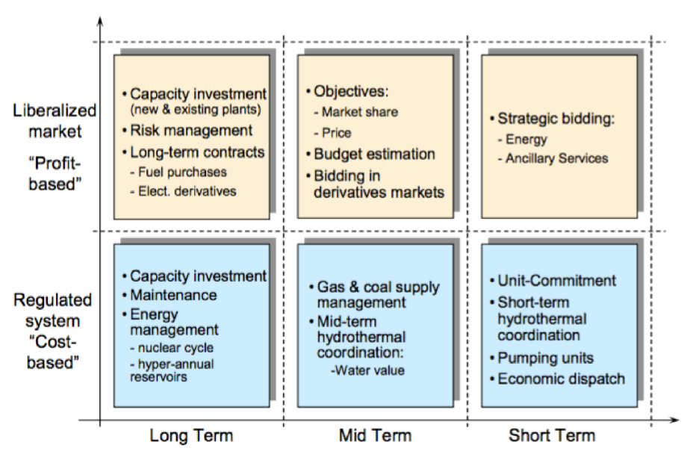
Methodology
A model should represent the short term operation solving the unit commitment (UC) or economic dispatch (ED) optimization problem
The optimization problem can be formulated with different levels of details
The model should account for the temporal and operational constraints
Assumptions:
Central dispatch and operation
The system operator co-optimizes energy and reserve in various ways
Javier Garcia Gonzalez, 2014
Notes:
A model should represent with a high level of detail the short term operation of large-scale power system, solving the unit commitment (UC) or economic dispatch (ED) optimization problem.
The optimization problem can be formalized with different levels of details which may capture power dispatch, power flow and security constraints.
The model should account for the temporal constraints as well as most operational details.
Assumptions:
Central operation with full information on the technical and economic data of the generation units, the demand in each node, and the transmission network.
The system operator co-optimizes energy and reserve in various ways

Slide 6
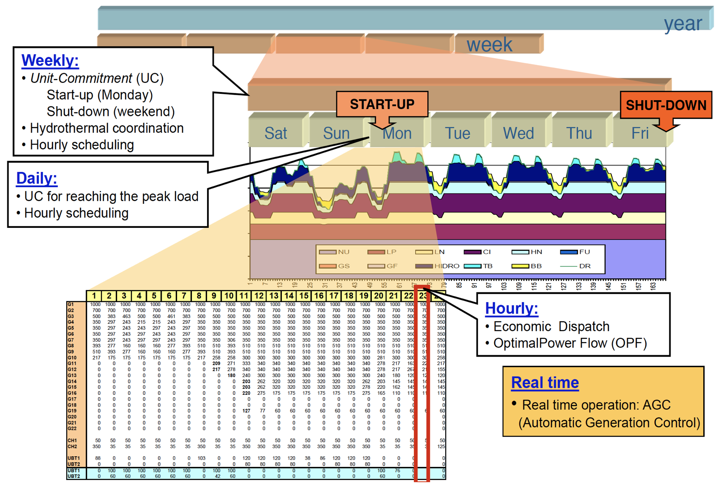
Suggested Formulations
Optimization time horizon may span each operating hour in a week ahead, or in a day ahead and sometimes down to each operating minute or second
Unit commitment (UC)
Generator ON or OFF at each hour and level of power (MILP, binary decision variables)
Economic dispatch (ED)
Level of power for ON generator (LP, removing the binary decision variables)
Optimal power flow (OPF)
How power flow along transmission network considering the voltage level and angle well as active and reactive power (it can be formulated within UC and ED)
González , Commitment, MIT, IAP-2018
Notes:
Optimization time horizon may span each operating hour in a week ahead, or in a day ahead and sometimes down to each operating minute or second
Unit commitment (UC)
Attempts to determine whether a generator should be on or off during each operating hour and how much power it generates (formulated as Mixed-Integer Linear Programming (MILP) model, using binary decision variables )
Economic dispatch (ED)
A relaxed version of UC model where it attempts to dispatch the generators that are already on-line in order to meet the demand in minute-by-minute basis (It can be formulated as Linear Programming (LP) model, removing the binary decision variables)
Optimal power flow (OPF)
A model that calculates how the power should flow along transmission network considering the voltage level and angle at each nodes as well as active and reactive power injections at each node (it can be formulated within UC and ED)

Slide 7
Model Inputs
Data for all regional power systems which may include (but not limited to):
GIS or the nodes they are connected to
Capacity
Minimum operating capacity
Technology and fuel
Efficiency or heat rates
Marginal production cost including fuel, fuel transportation and O&M costs
Start up and shut down costs
Ramping cost
Start-up time
Minimum up and down times
Ramp up and down rates
CO2 intensity
Storage capacity, charge and discharge rates, and charging efficiency
Scheduled outages for all plant units
Renewable potential data
Hourly or quarter-hourly demand data for all demand nodes. The nodes can be substations, Operating Areas (OA) or sub Operating Areas
Fuel prices and fuel subsidies, if any
Transmission network data (Net Transfer Capacity (NTC) of the lines or including resistances and reactance's)

Slide 8
Data Sources
Power demand (source: GCCIA & SEC)
Regional Intertie capacities (sources: SEC & published data) interties figure
Fuel prices (international & local subsidies) (sources: EIA & KAPSARC) fuel prices bar plot

Slide 9
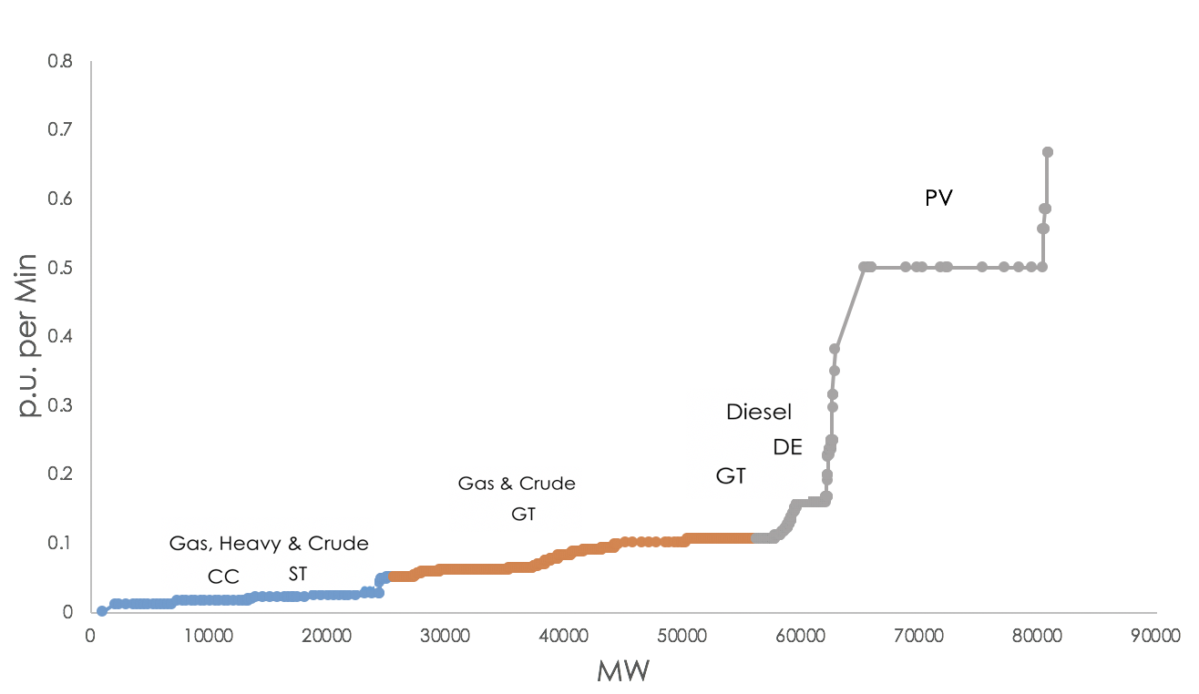
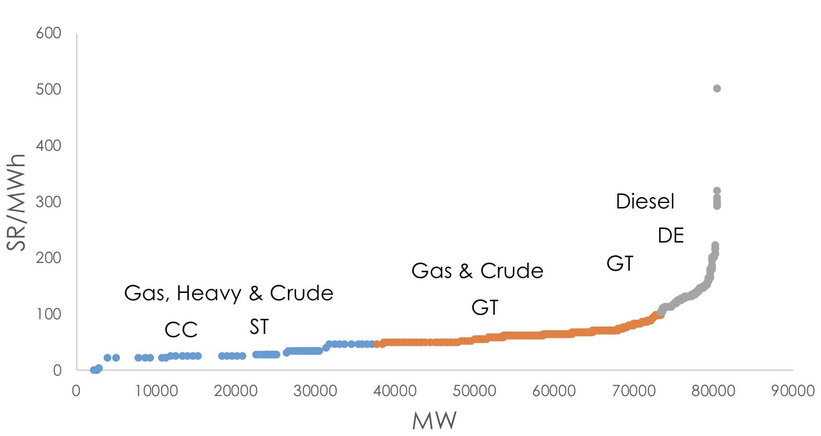
Data Sources
2016 Saudi power plants (source: SEC)
8 operation zones (regions)
650 power units distribution of fuel & technology (capacity & count)
Technical characteristics (missing some data) (distribution of ramping by capacity)
Cost data (missing some data) (marginal cost by technology & fuel)

Slide 10
Data Sources
2016 GCC power plants (source: Platts Power Plant Database)
5 operation zones (countries)
261 power units distribution of fuel & technology (capacity & count)
Technical characteristics (missing some data)
Cost data (missing some data) marginal cost by technology & fuel

Slide 11
Data Sources
Data sources to complete the missing data
EU sample power plants database (source: DispaSET)
9 countries (screenshot)
616 sample power units
Complete technical characteristics
Complete cost data

Slide 12
Data preprocessing
Missing data in Saudi power plants are completed from the following: missing data
“Saudi common parameters” if Non; screenshot look down
“EU common parameters” & IEA screenshot look down
Missing data in GCC power plants are completed from the following: missing data
“common heat rates” heat rates by technology&fuel look down
“Saudi common parameters” if Non;
“EU common parameters” & IEA
EU data was used to generate “EU common parameters” for each “Technology&Fuel” combination
Each parameter for each combination was calculated by the average of all records for each parameter of that combination
Assume same parameters regardless of plant age
“Saudi common parameters” was generated in the same manner
”Common heat rates” was generated for each “Technology&Fuel&Age” combination from Saudi data

Slide 13
Modeling scenarios
Economic impact (total operational cost & electricity prices) due to:
Reserves sharing
Energy trading
Fuel subsidy impact on:
Trade volume (exports & imports )
Subsidy exports (winner and losers)

Slide 14
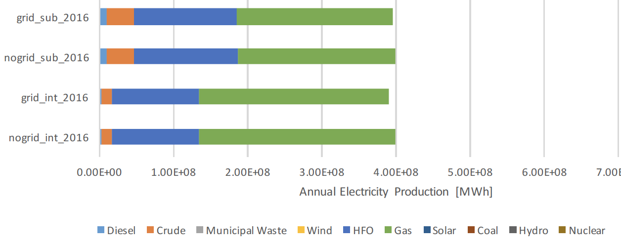
Expected results
Electricity generation by fuel type for different scenarios screenshot

Slide 15
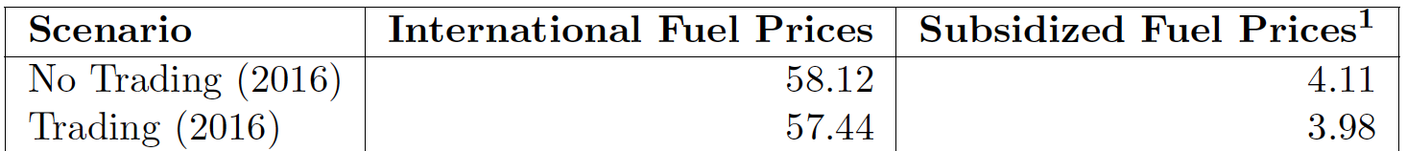
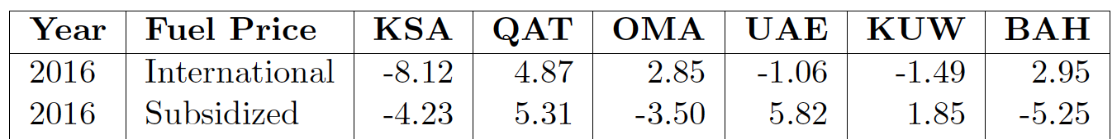
Expected results
Total operational costs
Net exports by country

Slide 16
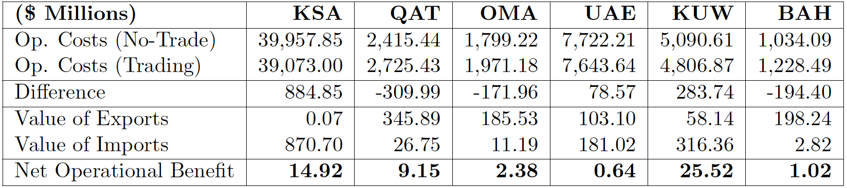
Expected results
Operational Cost Reductions from Trade

Slide 17
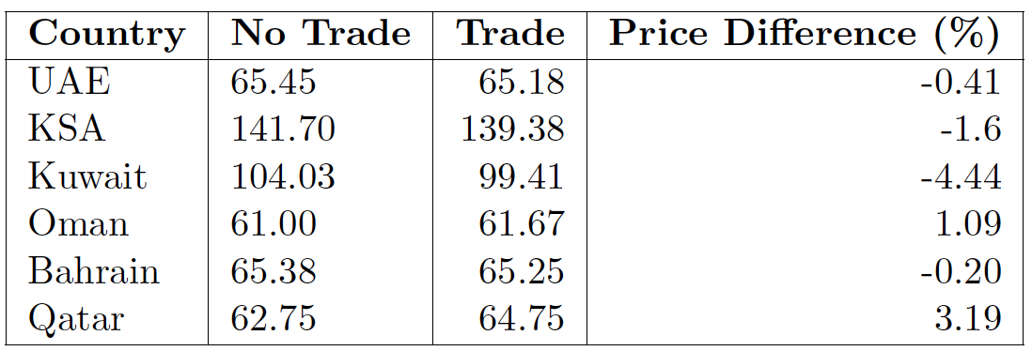
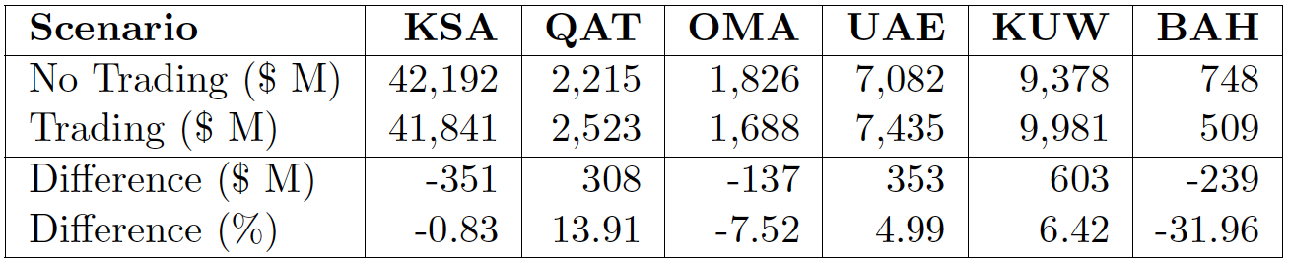
Expected results
Electricity prices ($/MWh)
Government spending on fuel subsidies

Slide 18
Future work
Study various reserve calculations
Incorporate Egypt in the model, if the data allows
Impact of introducing new generation technologies
Calculation of Locational Marginal Prices (LMPs) components
Visualization of LMPs

Slide 19
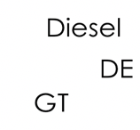
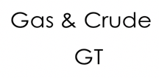
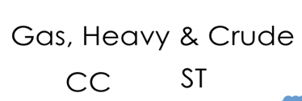
Data Sources
PV

Slide 20
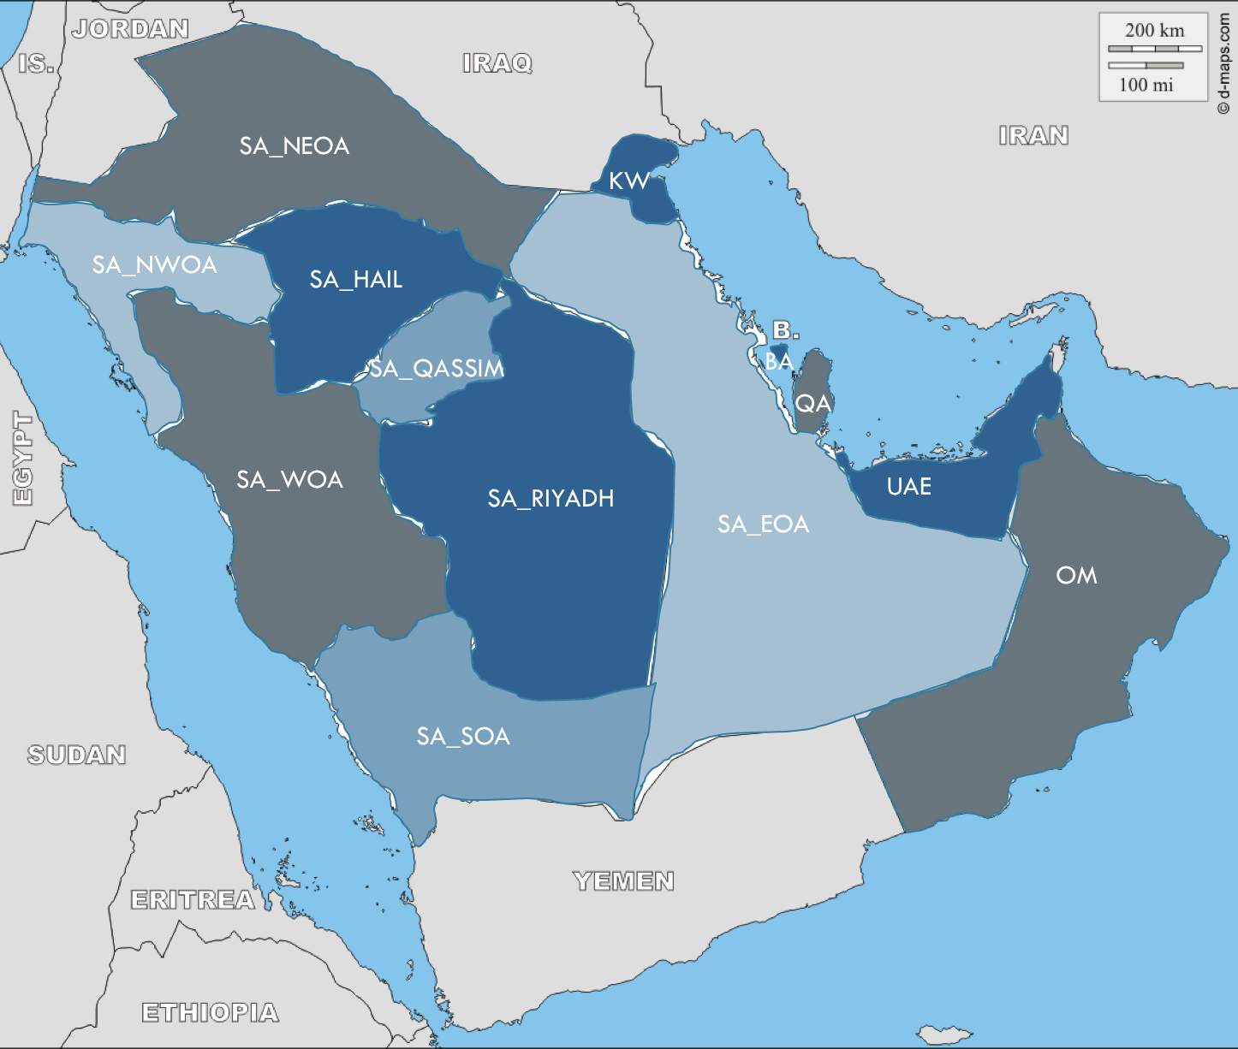
GCC Modeling
13 Zones:
2016 hourly demand
Real time
Day ahead
Power plants & their parameters
Interties capacity (NTC)
Availability Factors for renewables (time series) [% of capacity each hour]
Fuel prices

Slide 21
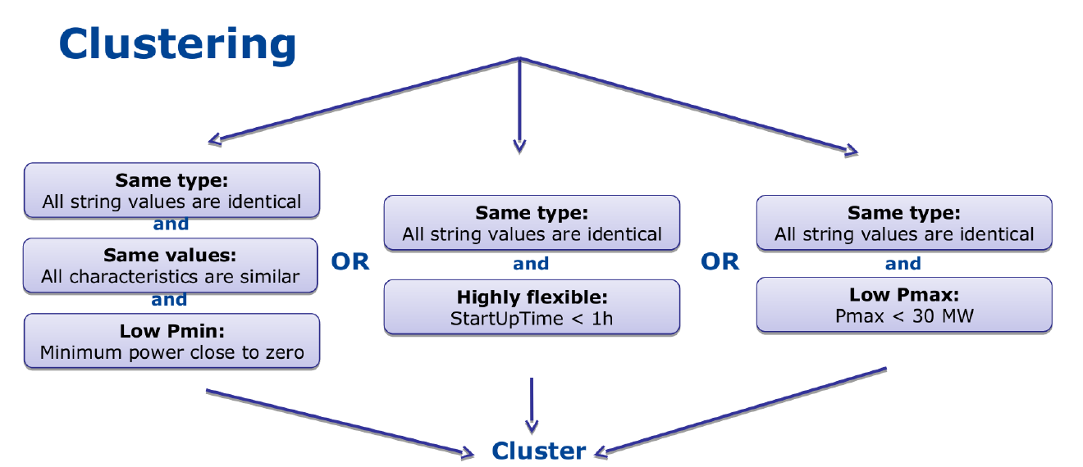
GCC Modeling
Generation units parameters (can be either unit-specific or technology-specific):
Clustering:
MILP clustering
LP clustering
PowerCapacity | Unit | Zone | Technology | Fuel | Efficiency | MinUpTime | MinDownTime | RampUpRate | RampDownRate | StartUpCost | NoLoadCost | RampingCost | PartLoadMin | MinEfficiency | StartUpTime | CO2Intensity
Source: DispaSET Documentation, Release v2.2-35-gefcdfdb

Slide 22
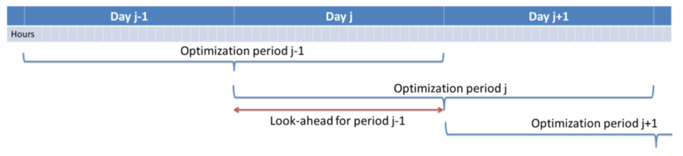
GCC Modeling
5 days Horizon length & 1 day look ahead

Slide 23
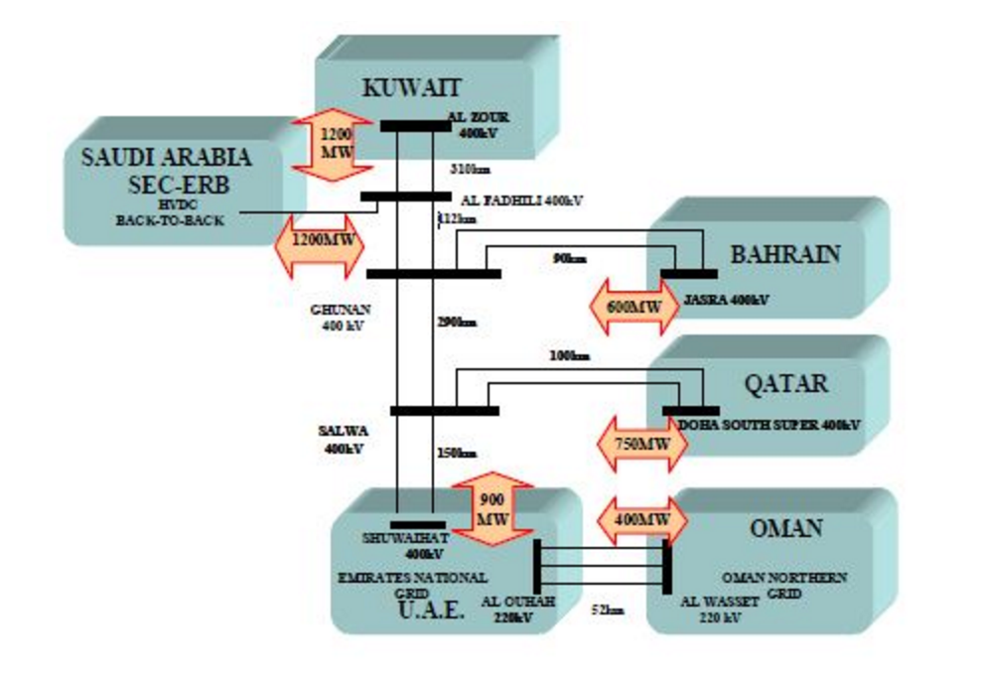
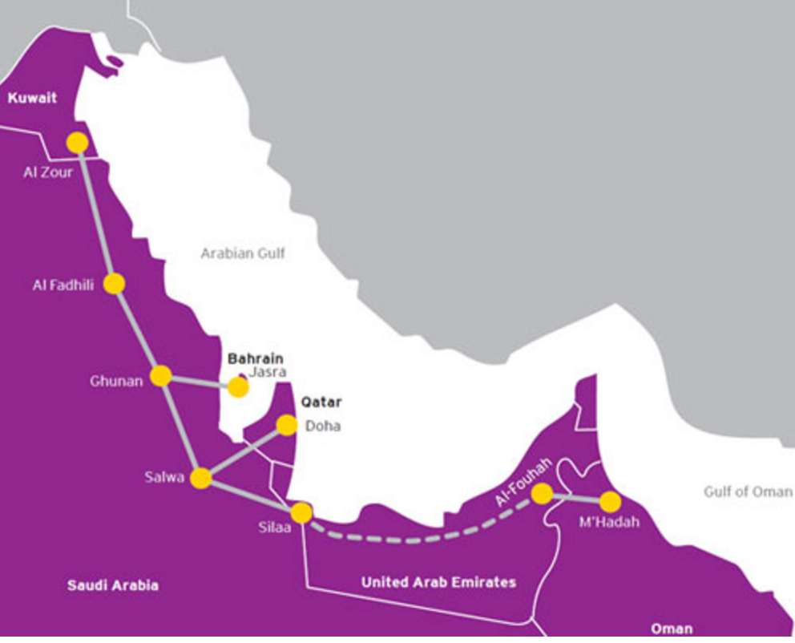
The GCC interconnection
The interconnection project connect the electrical grid between the GCC countries.

Slide 24
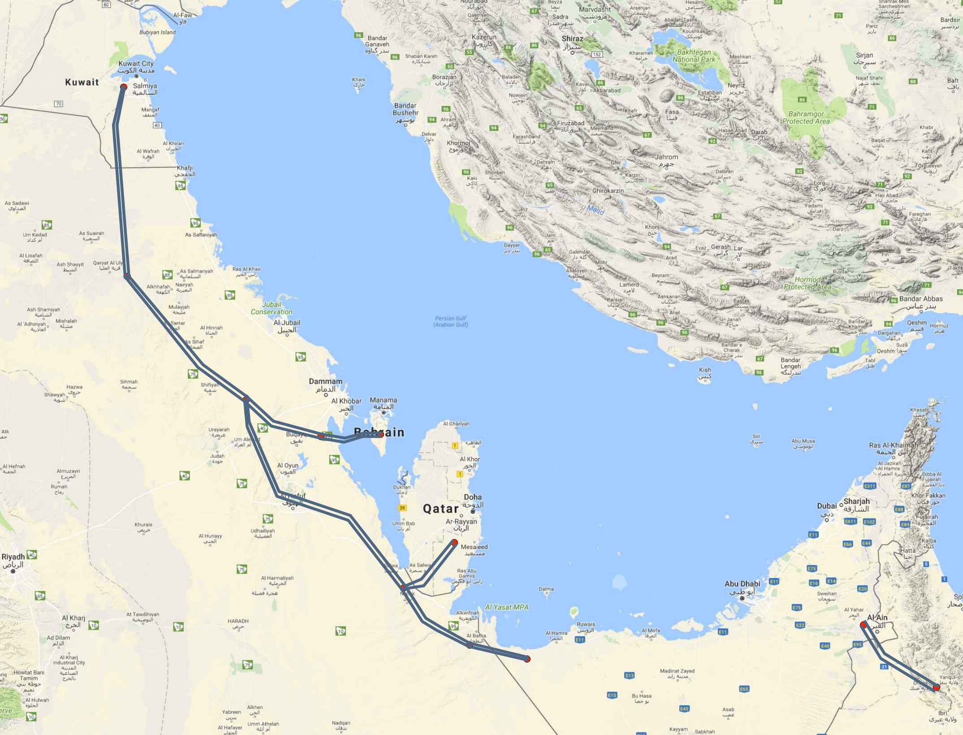
Collaboration with the GCCIA: Data
Demand:
Hourly demand in 2016 for the 6 countries
Network data:
Data for the GCCIA interconnector: length, R&X, and total capacity for each line

Slide 25
Supply curves
Wind abundance in Oman and

Slide 26
GCC Interconnection
Research questions:
Q1. How can we optimize the utilization of energy resources in the GCC sates?
Q2. What are the the possible binding constraints on power trading?
Q3. What is the potential operational savings from power trading?
Q4. How can we evaluate the operation of GCC power systems?
Q3. What are the impacts of the variable and uncertain RES on the system operation?

Slide 27
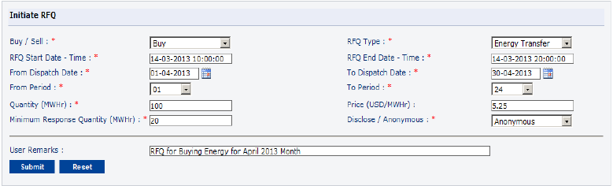
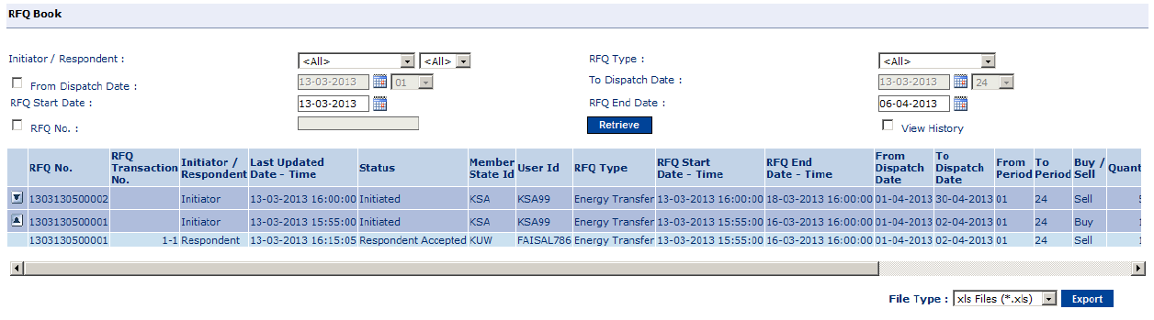
GCCIA current and future practice
Three types of markets:
OTC
Day ahead market
Intra-day market

Slide 28
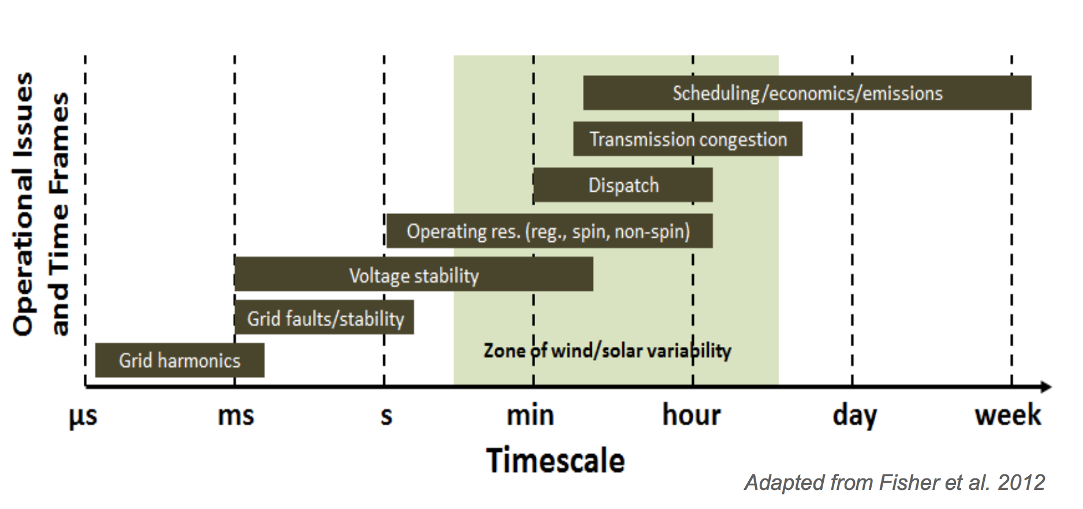
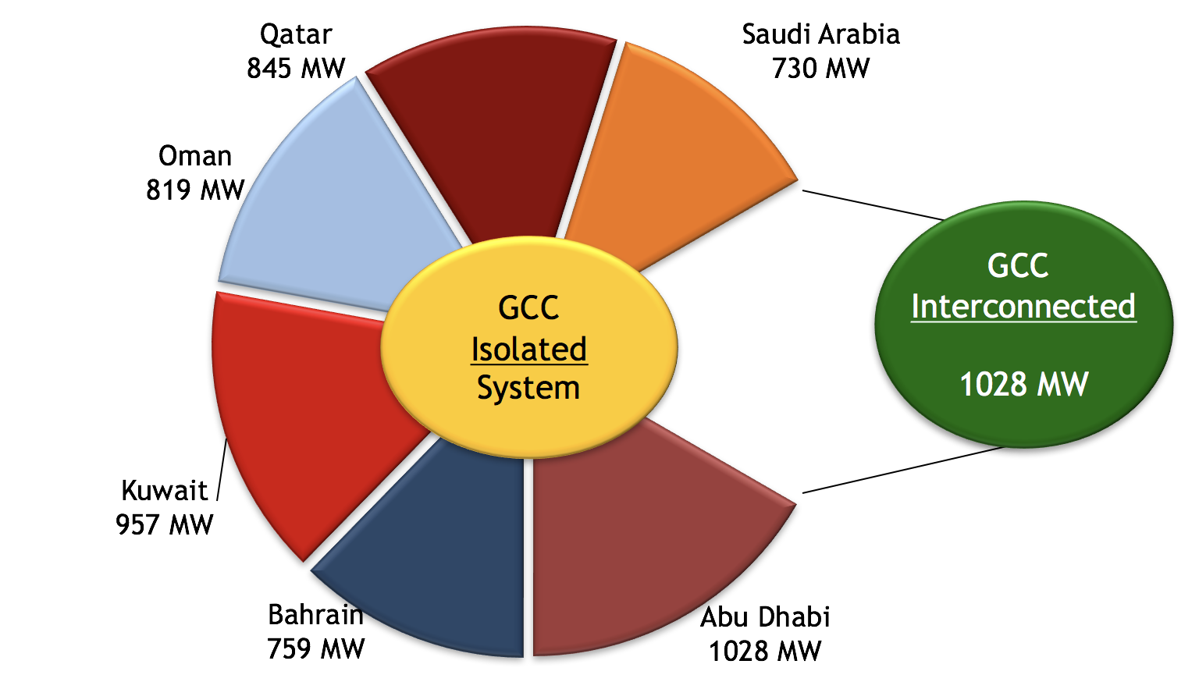
Energy trading and time frames
Potential tradings:
Energy
Ancillary (balancing) services
Reserve services
Load-following services
Regulation services
Reactive supply and voltage control
Capacity (satisfy peak demand)
Trading schemes
Bilateral trading
Spot market
Day ahead
Intra day
Real time
The spinning reserve requirement of 2014 in case of an isolated system is 5,138 MW and interconnected system is 1028 MW

Slide 29
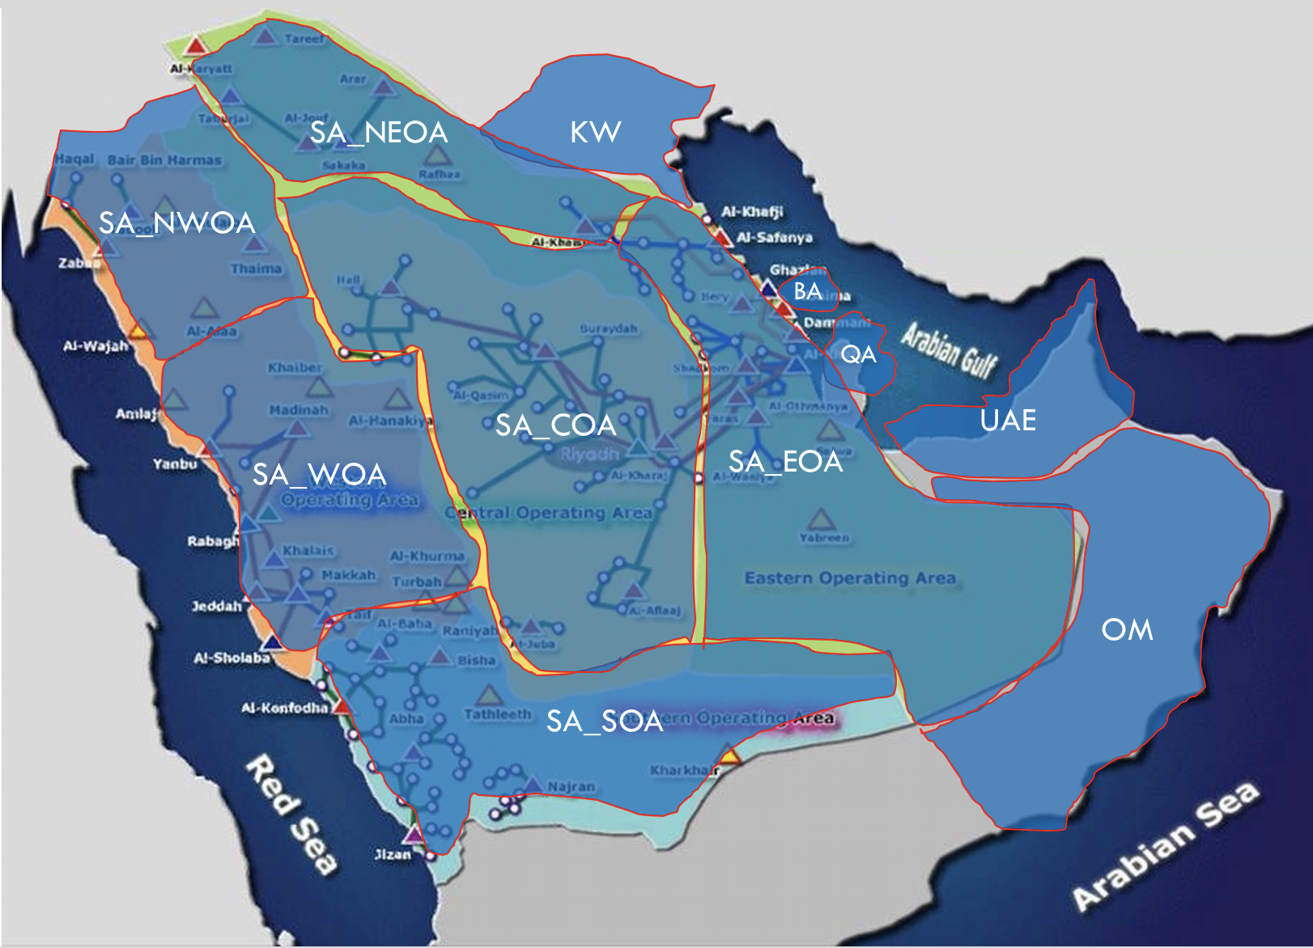
System Modeling
Potential savings and trade opportunities can be explored via modeling the GCC system.
Granularity of the modeling depends on the available data:
Hourly power across: countries, zones, or detailed network topology.
Power plants: Individual units, or aggregates by technology, fuel…etc.

Slide 30

System Modeling
Dispa-SET is a free software licensed under the “European Union Public Licence” EUPL v1.1
Developed within the “Joint Research Centre” of the European Commission
Written in GAMS and Python and uses csv files for input data
The aim is to model the short-term operation of large-scale power systems solving the UC problem.
considering that the system is managed by a central operator with full information on the technical and economic data of the generation units, the demands in each node (or zone), and the transmission network.
Defined as LP or MILP problem, depending on the desired level of accuracy and complexity

Slide 31
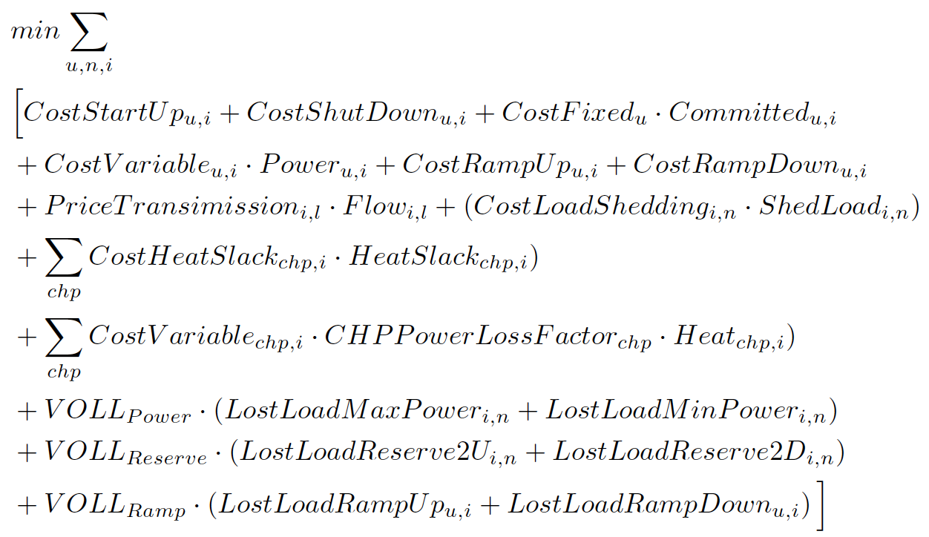
System Modeling
Objective function:
Fixed costs: depending on whether the unit is on or off
Variable costs: stemming from the power output of the units.
Start-up costs: due to the start-up of a unit.
Shut-down costs: due to the shut-down of a unit.
Ramp-up: emerging from the ramping up of a unit.
Ramp-down: emerging from the ramping down of a unit.
Load shed: due to necessary load shedding.
Loss of load: power exceeding the demand or not matching it
subject to:
Demand related Constraints: supply-demand balance, upward and downward reserves.
Power output bounds and ramping capabilities
Mini mum up & down times
Storage related constrains: storage capacity, charging capacity, charge/discharge efficiency
Network-related constraints
Curtailments and load shedding

Slide 32
System Modeling
Rolling horizon
example in which the optimization horizon is one day, with a look-ahead (or overlap) period of one day.
The look-ahead period is modelled to avoid issues related to the end of the optimization period such as starting low-cost but non-flexible power plants.

Slide 33
system Modeling
Input data
Power plant units and demand nodes (zones)
Interconnections: modeling exchanges between countries (or zones) using Net Transfer Capacities (NTC) (however, DC power-flow is ongoing work)
Generation unit defined with the pair of values (technology, fuel)
Parameters can be either unit-specific or technology-specific.
Time series Demand
Fuel Prices

Slide 34
Dispa-SET model
Dispa-SET is a free software licensed under the “European Union Public Licence” EUPL v1.1
Developed within the “Joint Research Centre” of the European Commission
Written in GAMS and Python and uses csv files for input data
The aim is to model the short-term operation of large-scale power systems solving the UC problem.
considering that the system is managed by a central operator with full information on the technical and economic data of the generation units, the demands in each node, and the transmission network.
Defined as LP or MILP problem, depending on the desired level of accuracy and complexity

Slide 35
Dispa-set model
Input data
Power plant units and demand nodes (zones)
Interconnections: modeling exchanges between countries (or zones) using Net Transfer Capacities (NTC) (however, DC power-flow is ongoing work)
Generation unit defined with the pair of values (technology, fuel)
Parameters can be either unit-specific or technology-specific.
Time series Demand
Fuel Prices

Slide 36
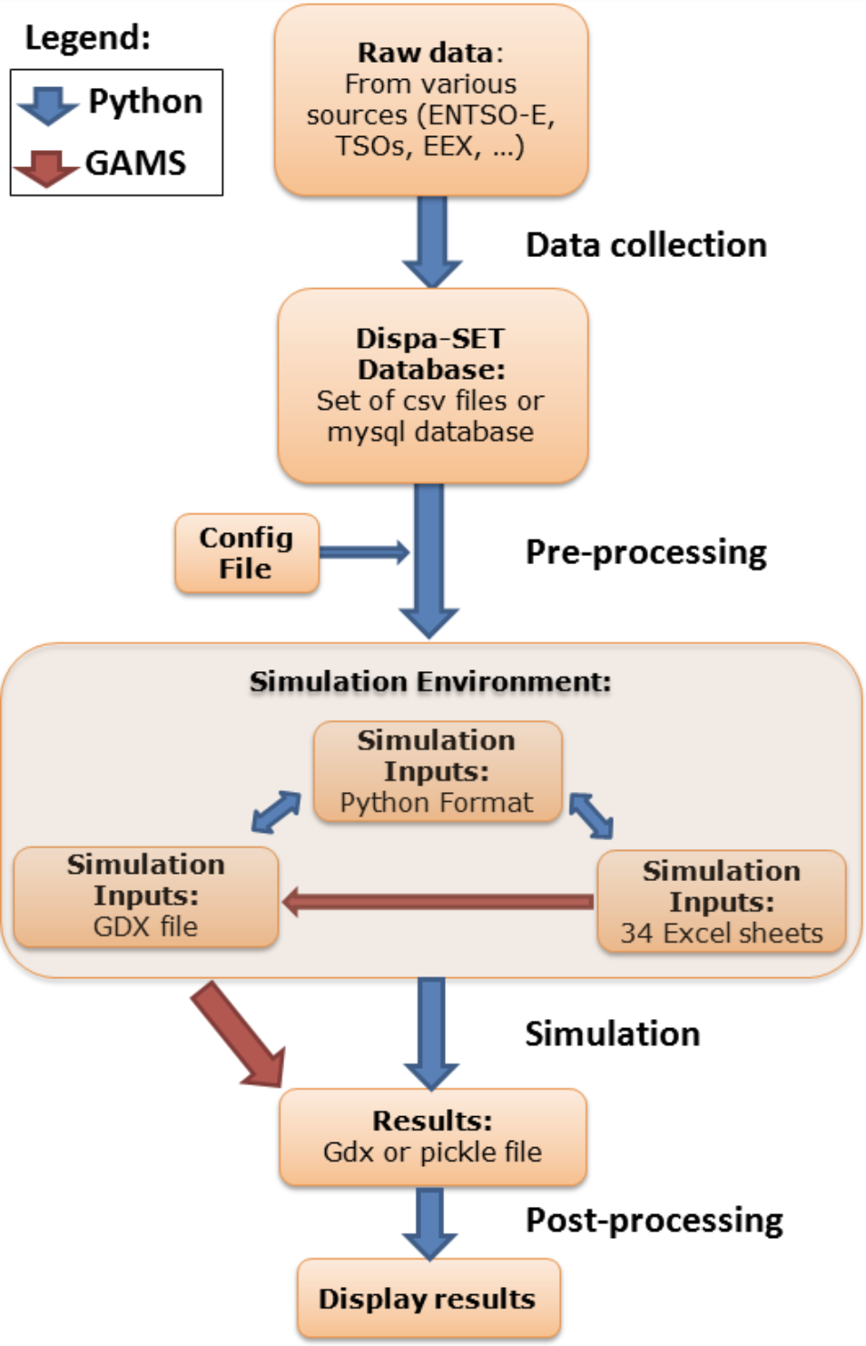
Dispa-set model
Implementation and interface (Dispa-SET v2.2)
Fill the Dispa-SET database with properly formatted data (time series, power plant data, etc.)
Configure the simulation parameters (rolling horizon, data slicing) in the configuration file.
Generate the simulation environment which comprises the inputs of the optimization
Open the GAMS simulation files and run the model.
Read and display the simulation results.

Slide 37
Model ongoing development
Grid constraints (DC power-flow)
Stochastic scenarios
Extension of the modeled areas
Modeling of the ancillary markets
User interface

Slide 38
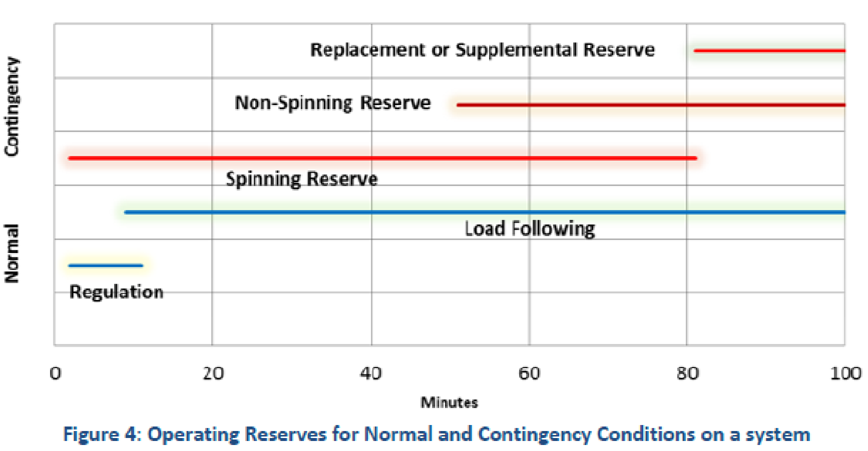
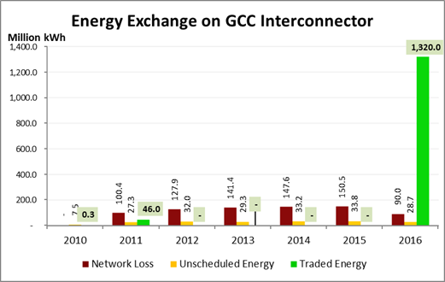
Q5. How different trading schemes can impact the economic efficiency?
Potential tradings:
Energy
Ancillary (balancing) services
Reserve services
Load-following services
Regulation services
Reactive supply and voltage control
Capacity
Trading schemes
Bilateral trading
Spot market
Day ahead
Intra day
Real time
NERC Essential Reliability Services 5
Net exports of all Member States
The spinning reserve requirement of 2014 in case of an isolated system is 5,138 MW and interconnected system is 1028 MW

Slide 39
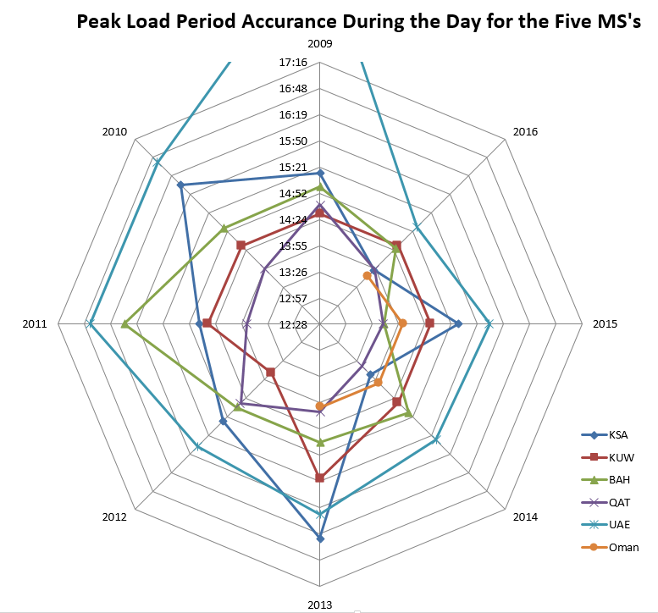
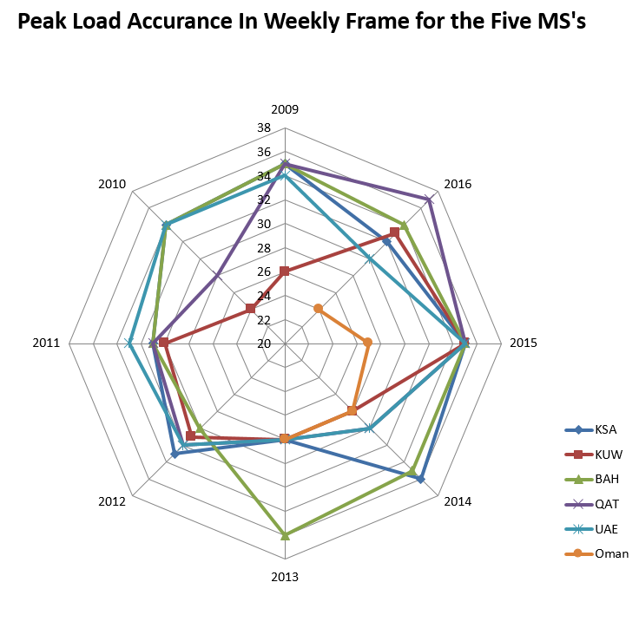
Q1. What is the potential operational savings from power trading?
To meet the peak demand, or generally the demand, for each state:
Operate the most economic power plants in isolation of other states
Operate the most economic power plants across the states
GCCIA studies, total savings from power trading among the states for the period (2014 -2038):
$23.57bn in fuel and non-fuel variable O&M costs

Slide 40
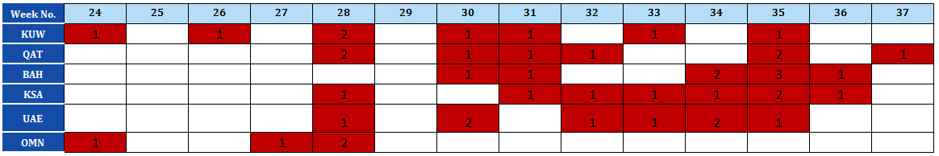
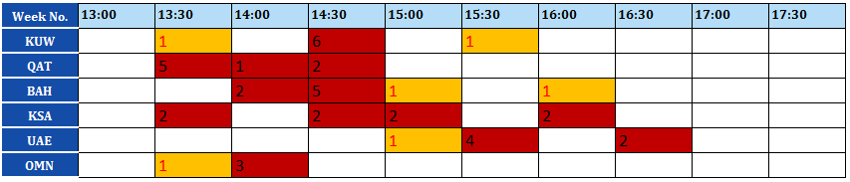
Q5.1 How different time frames of trading impact the economic efficiency?
Opportunities in the Monthly or Day Ahead Market
Numbers represent the most likely peak appearing in each of member states
Opportunities in the Intraday Market
Numbers represent the most likely peak appearing in each of member states

Slide 42
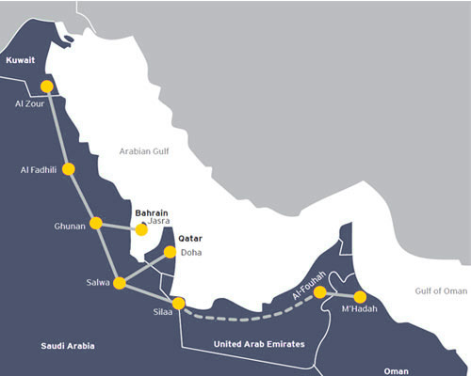
Cross-border power trading
What is the potential operational savings from power trading?
What is the potential operational savings from transmission and capacity expansion?
What types of energy to be traded? dispatch, spinning & non-spinning reserves, load following, and voltage stability…
GCCIA Annual Report

Slide 43
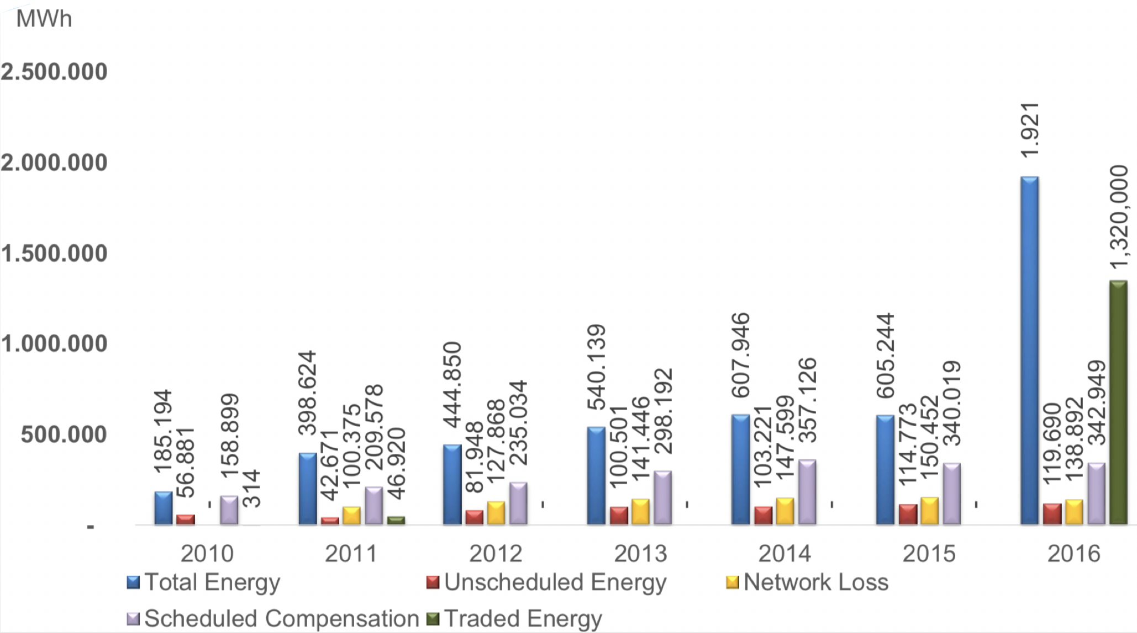
Cross-border power trading
Gulf Cooperation Council Interconnection Authority (GCCIA)
Over-The-Counter (OTC) trading
Day-ahead market
Intra-day trading
The spinning reserve requirement of 2014 in case of an isolated system is 5,138 MW and interconnected system is 1028 MW
“The Prospects of a Power Exchange in the GCC”
Over-The-Counter (OTC) trading
Day-ahead market: Supply offers and demand bids
Intra-day continuous trading: (bilateral trading within the day)

Slide 44
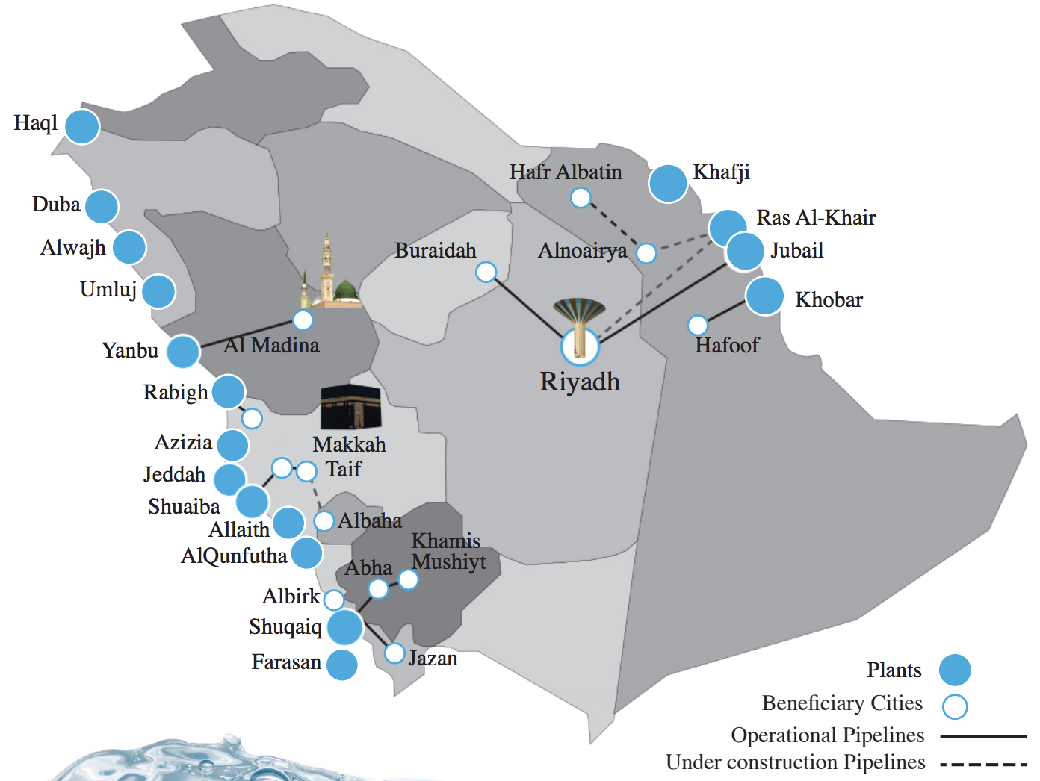
Cross-border power trading
Water-Energy nexus
How to meet energy & water demand while efficiently utilizing the resources?
Coordination of desalination cogeneration, power dispatch and water storage

Slide 45
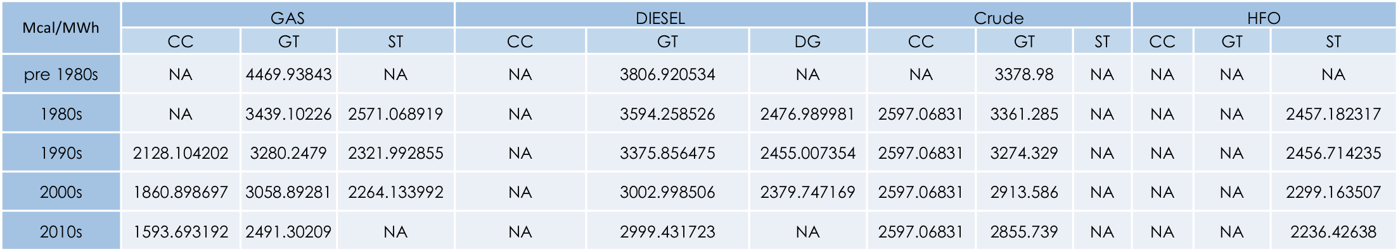
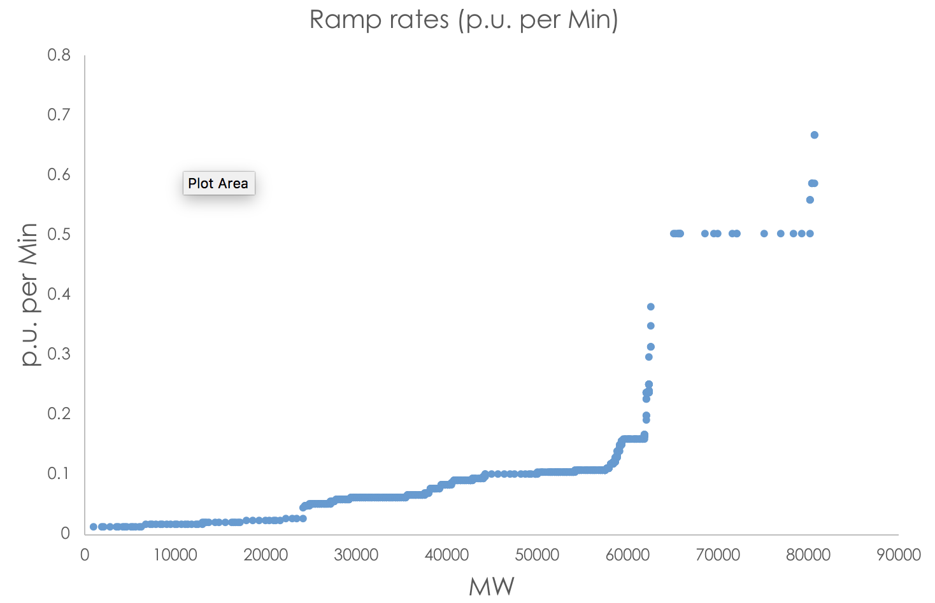
Cross-border power trading
Typical power dispatch problem requires detailed modeling of the power system
Fuel constrains: availability & transportation cost
Power plant constrains: efficiency & operational constraints

Slide 46
Cross-border power trading
Objective function:
Fixed costs.
Variable costs.
Start-up costs.
Shut-down costs.
Ramp-up costs
Ramp-down costs
Load shed costs
Subject to:
Demand related Constraints: supply-demand balance, upward and downward reserves.
Power output bounds and ramping capabilities
Mini mum up & down times
Network-related constraints
Curtailments and load shedding
Rolling horizon
The look-ahead period is modelled to avoid issues related to the end of the optimization period such as starting low-cost but non-flexible power plants.

Slide 47
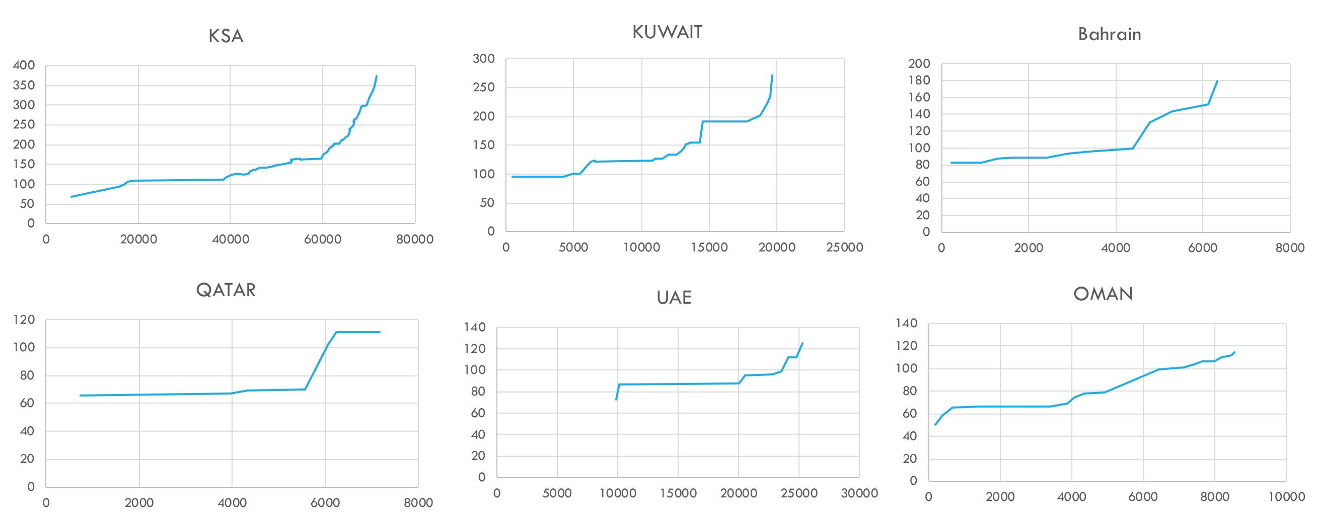
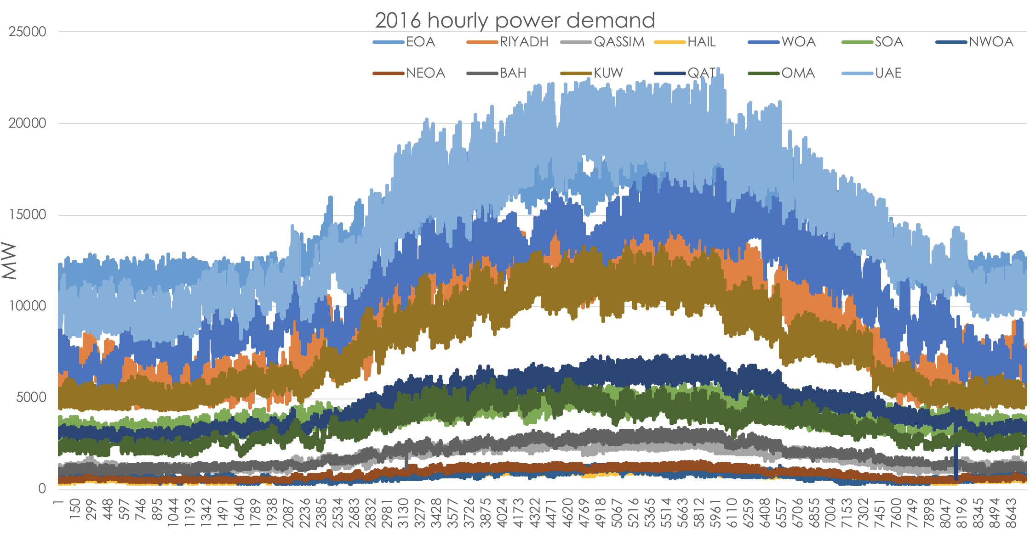
Cross-border power trading
System Modeling
Network data and Interties capacities (NTC)
Power plants portfolio: Individual units with their detailed parameters
Hourly demand in 2016 for the 13 zones
International fuel prices

